Slide 1
Second Year B. Tech. Advanced Data Structures (CS228)
By
Dr. Pramod D. Ganjewar
Senior Assistant Professor,
School of Computer Engineering,
MIT Academy of Engineering, Alandi(D.),Pune

Slide 2
Unit – 1 Trees Binary Tree Construction from its traversal Sequences

Slide 3
Binary Tree Construction from its given traversal Sequences
Following are the two methods, where binary tree can e constructed from its given traversal sequences
Binary Tree Construction from its in-order and Pre-­order sequence
Binary Tree Construction from its In-order and Post­-order sequence
Note : Binary Tree Construction from its Pre-order and Post­-order sequence is not possible.

Slide 4
1. Binary Tree Construction from its in-order and pre­order sequence :-
Algorithm for Construction of Binary Tree from its In-order and Preorder :
First element in pre­order[] will be the root of the tree.
Search element in inorder[], and let i be position
Make note of elements which are left to i, construct the left sub-tree and elements which are right to I, to construct the right sub-tree.
Search second element of preorder by repeating step 2 and 3 and so on until all elements of preorder are searched in in-order sequence

Slide 5
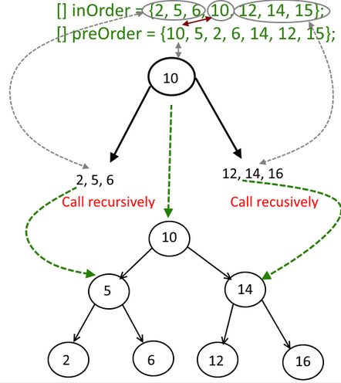
Example 1 :
Construct Binary tree from given Inorder and Preorder Sequence :
In-order : 2,5,6,10,12,14,16
Preorder: 10,5,2,6,14,12,16

Slide 6

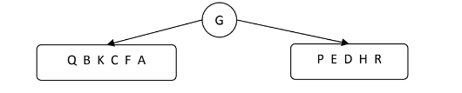
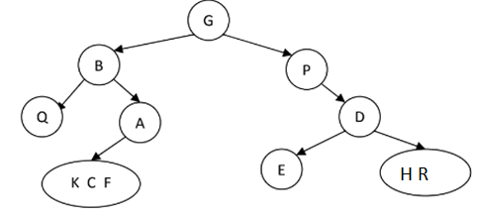
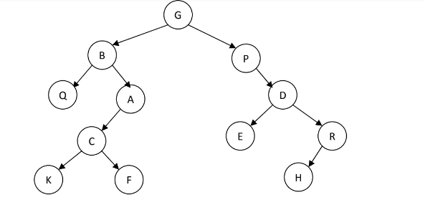
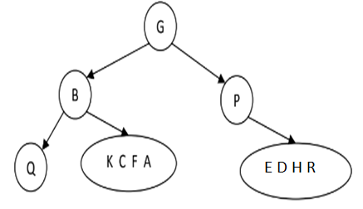
Example 2 : Construct Binary tree from given Inorder and Preorder Sequence :

Slide 7
Practice Example 1 : CREATE A BINARY TREE FOR INORDER : g d h b e i a f j c PREORDER : a b d g h e i c f j Practice Example 1 : CREATE A BINARY TREE FOR INORDER : E A C K F H D B G PREORDER : F A E K C D H G B

Slide 8
2. Construction of Binary Tree from its In-order and Post­order sequence
Algorithm for Construction of Binary Tree from its Inorder and Postorder Sequence :
Last element in post­order[] will be the root of the tree.
Search element in inorder[], and let i be position
Make note of elements which are left to i , construct the left sub-tree and elements which are right to i to construct the right sub-tree.
Search second element from back(reverse reading) of postorder by repeating step 2 and 3 and so on until all elements of postorder are searched in in-order sequence.

Slide 9

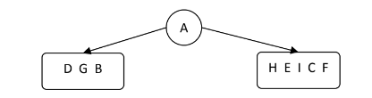
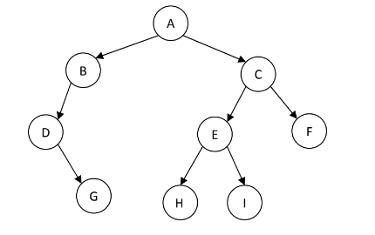
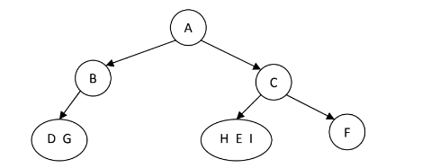
Example : Construction of Binary Tree from In-order and Post-order Sequence.

Slide 10
Thank You

